Slide 1

discrete structures

Slide 2

Outline
Properties of Binary relation
(types of relation)
Reflexive relation.
Irreflexive relation.
Symmetric relation.
Antisymmetric relation.
Transitive relation.
Asymmetric Relation:

Slide 3
Reflexive Relation :
A relation R on a set A is called reflexive if (a, a) ЄR
for every element aЄA.In other words.Va((a, a) ЄR).
Example: Let A = { 1, 2, 3, 4 }
R₁ = { (1, 1), (1, 2), (2, 2), (2, 3), (3, 3), (4, 4) }.
Relation R1 is reflexive because it contains all ordered pairs of the form (a, a) for every element aЄA.
i.e, R1 ={(1, 1), (2, 2), (3, 3), (4, 4}.
R2, = {(1, 1), (1, 2), (2, 1), (2, 2), (3, 1), (4, 4)}.
Relation R2 is not reflexive because the ordered pair (3, 3)
is not in R2.

Slide 4
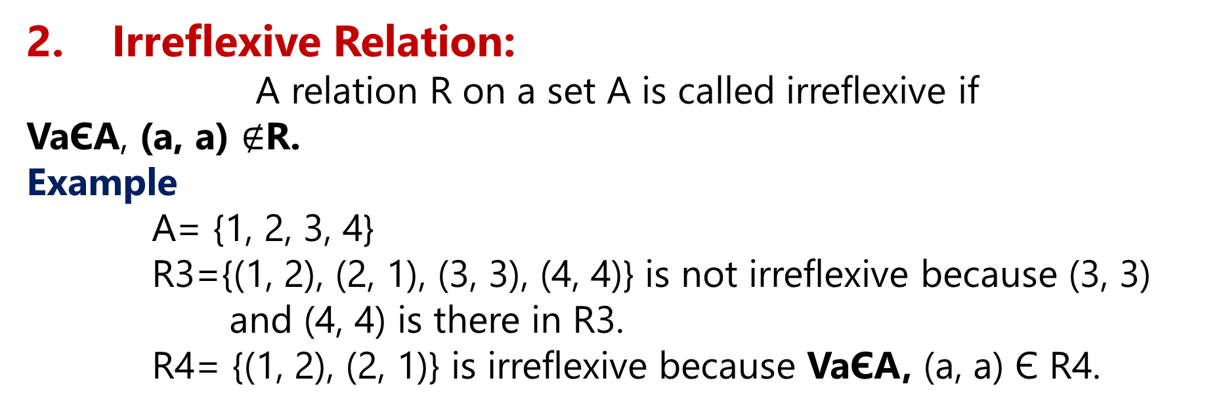
.
2. Irreflexive Relation:
A relation R on a set A is called irreflexive if
VaЄA, (a, a) $∉$R.
Example
A= {1, 2, 3, 4}
R3={(1, 2), (2, 1), (3, 3), (4, 4)} is not irreflexive because (3, 3) and (4, 4) is there in R3.
R4= {(1, 2), (2, 1)} is irreflexive because VaЄA, (a, a) Є R4.

Slide 5
.
3. Symmetric Relation:
A relation R on a set A is called symmetric if (b, a) ЄR holds when (a, b) ЄR for all (a, b) ЄA .
In other words, relation R on a set A is symmetric if
VaVb((a, b) R (b, a) ЄR)
Example:
Relation R5= {(1, 1), (1, 2), (2, 1), (2, 2)) is symmetric because for every (a, b) Є R5 (b, a) ЄR5
like (1, 2) (2, 1) is in R5.
There is no need to check for (1, 1), (2, 2).
Relation R6= ((1, 1), (1, 2), (1, 3), (1, 4)) is not symmetric because for (1, 2) there is no (2, 1) in R6. Same is true for (1, 3) and (1, 4).

Slide 6
4 . Antisymmetric relation.
A relation R on a set A is called antisymmetric if VaVb((a, b)R (b, a)ER (a = b)) Whenever we have (a, b) in R, we will never have (b, a) in R until or unless (a = b)
Example :
Relation R7= {(1, 1), (2, 1)}on set A is antisymmetric because (2, 1) is in R7 but (1, 2) is not in R7.

Slide 7
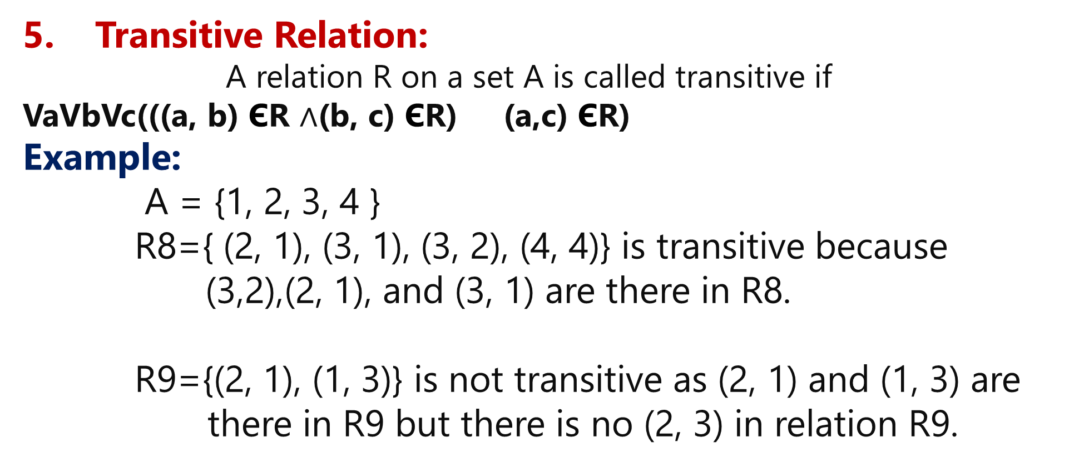
.
5. Transitive Relation:
A relation R on a set A is called transitive if
VaVbVc(((a, b) ЄR $∧$(b, c) ЄR) (a,c) ЄR)
Example:
A = {1, 2, 3, 4 }
R8={ (2, 1), (3, 1), (3, 2), (4, 4)} is transitive because
(3,2),(2, 1), and (3, 1) are there in R8.
R9={(2, 1), (1, 3)} is not transitive as (2, 1) and (1, 3) are there in R9 but there is no (2, 3) in relation R9.

Slide 8
.
Asymmetric Relation:
A relation R on a set A is called asymmetric if VaVb((a, b) ЄR (b,o)R)
Example:
A= {1, 2, 3, 4}
R10={(1, 1), (1, 2), (1, 3)} is not an asymmetric relation because of (1, 1).
R11= {(1, 2), (1, 3), (2, 3)) is an asymmetric relation.

Slide 9
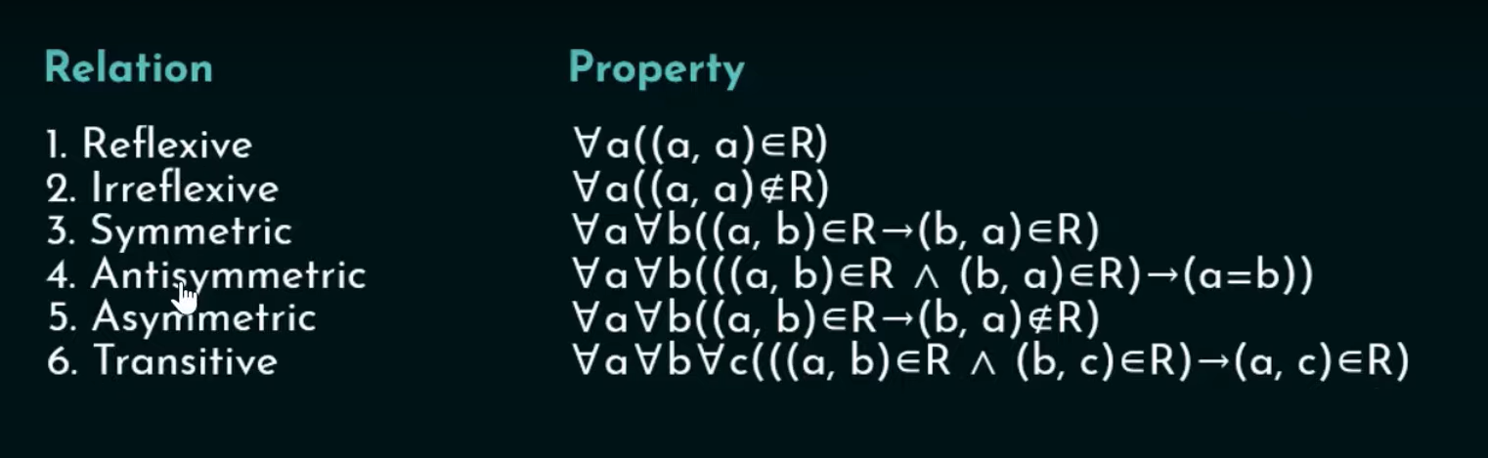
SUMMARY

Slide 10
Thank You !

